Slide 1
Data Structures 資料結構
Sorting – Part II
Department of Computer Science
National Tsing Hua University

Slide 2
External Sort
The lists to be sorted are so large that the whole list cannot be loaded into the internal memory.
The list could reside on a disk and the sorting algorithm could read partial records, perform the sorting and write the result back to disk.
The term “block” refers to the unit of data that is read from or written to a disk at one time.

Slide 3
External Sort (cont’d)
What kinds of internal sorts could be external?
Insertion sort, Quick sort, Heap sort…..NO
Merge sort………………………………………….YES
How will it work?
Segments of input lists are sorted using a good internal sort (the sorted segment is called run).
The runs generated in phase one are merged together following the merge-tree pattern.
Why merge sort?
Sublists could be sorted independently and merged later.
During the merging, only the leading records of the two runs needed to be loaded in memory.

Slide 4
Runs & Merge Tree
Merge tree

Slide 5
Example
Problem:
Internal memory: 750 records.
Block size: 250 records.
List to be sorted: 4500 records.
Internally sort three blocks at a time to obtain six runs.
3個block = 1個run
Run 1
Run 2
Run 6
3
5
15
3
5
15
…
3
5
15
250 250 250

Slide 6
Example (cont’d)
Set internal memory into 3 blocks:
Two input blocks and one output block.
Records in two input blocks are merged and store in output block.
To merge R1 and R2:
The first blocks of R1 and R2 are read into input buffers
The merged data is written to output buffer
Output buffer full => write onto disk
Input buffer empty => read from the new block

Slide 7
Example (cont’d)
Internal Memory
Disk
Input buffer
Run 1
Input buffer
Run 2
merge
Output buffer

Slide 8
Estimated Time
t_{io} : time to input/output one block
t_{is} : time to sort 750 records
t_{m} : time to merge n records from input buffer to output buffer
Internal sort of each run
read in 18 blocks 18 t_{io}
internal sort 6 t_{is}
write out 18 blocks 18 t_{io}
Merge R1 to R6
read in 18 blocks 18 t_{io}
merge 4500 t_{m}
write out 18 blocks 18 t_{io}

Slide 9
Estimated Time (cont’d)
Merge two runs of 6 blocks each (12 blocks, 3000 records)
24 t_{io} + 3000 t_{m}
Merge the run of 12 blocks and one run of 6 blocks (18 blocks, 4500 records)
36 t_{io} + 4500 t_{m}
Total : 132 t_{io} + 12000 t_{m} + 6 t_{is}
132 t_{io} : I/O time
12000 t_{m} + 6 t_{is} : CPU time
Parallel(multicores) machine 132 t_{io}

Slide 10
Optimal Merging of Runs
Runs with different sizes.
Different merge sequence may result in different runtime.
Internal nodes (Merging)
15
5
2
4
5
15
2
4
External nodes (Run and its size)

Slide 11
Runtime Evaluation
Merge tree A
Merge tree B
15
5
2
4
5
15
2
4
Cost = (2+4) + (2+4+5) + (2+4+5+15)
= 2*3 + 4*3 + 5*2 + 15*1
= 43
Cost = 2*2 + 4*2 + 5*2 + 15*2
= 52

Slide 12
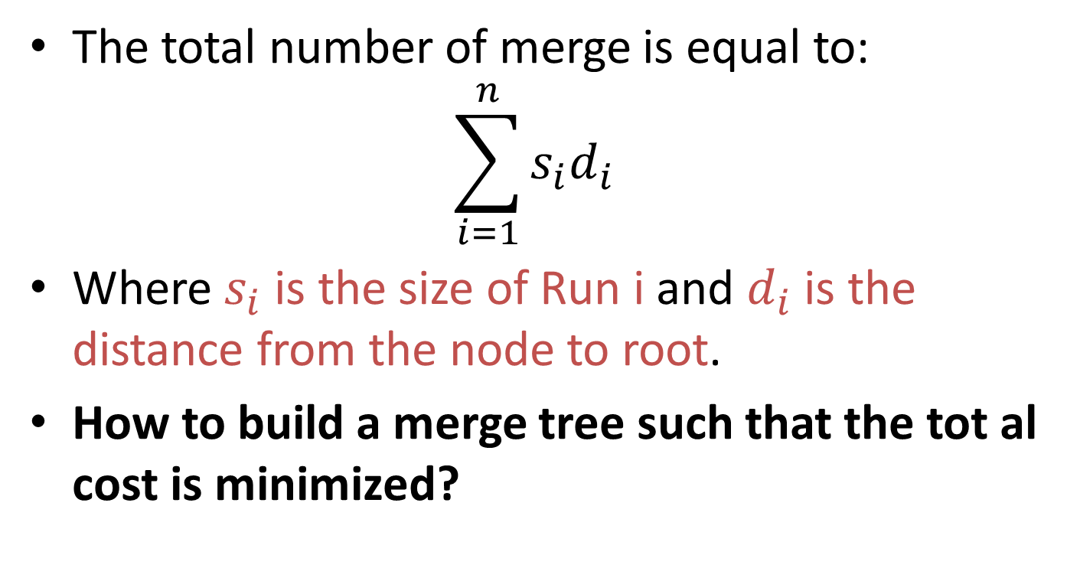
Weighted External Path Length
The total number of merge is equal to:
$$\sum_{i=1}^{n}{s_{i}d_{i}}$$
Where $s_{i}$ is the size of Run i and $d_{i}$ is the distance from the node to root.
How to build a merge tree such that the tot al cost is minimized?

Slide 13
Weighted External Path Length
Sort runs using its size.
Take the two runs with least sizes and combine them into a tree.
Repeat the process until we obtain one tree.
2
4
5
15
26
11
6
2
4
5
15
2
4
5
15
2
4
5
15

Slide 14
Message Encoding
Given a set of messages {M₁ , M₂ , …, M_{i}}
How do we encode each M_{i} using a binary code such that each code is unique?
 | Encode 1 | Encode 2 | Encode 3
M₁ | 0 | 0001 | 0001
M₂ | 1 | 0010 | 1
M₃ | 10 | 0100 | 01
M₄ | 11 | 1000 | 001

Slide 15
Message Encoding (cont’d)
Taking the 1st encoding {M₁(0), M₂(1) , M₃(01) , M₄(10)}.
Now you receive a code {0 1 0 1 0 1 }, can you decode it to corresponding messages?
NO!
There are more than one possible result!
M_{1,} M_{2,} M_{1,} M_{2,} M_{1 ,} M₂ or
M_{3,} M_{1,} M_{4,} M₂
No code is a “Prefix” of all other codes.

Slide 16
Huffman Codes
Using a binary tree, called decode tree to encode messages.
 | Huffman Codes
M₁ | 000
M₂ | 001
M₃ | 01
M₄ | 1
0
1
M₄
0
1
M₃
0
1
M₁
M₂
Decode tree

Slide 17
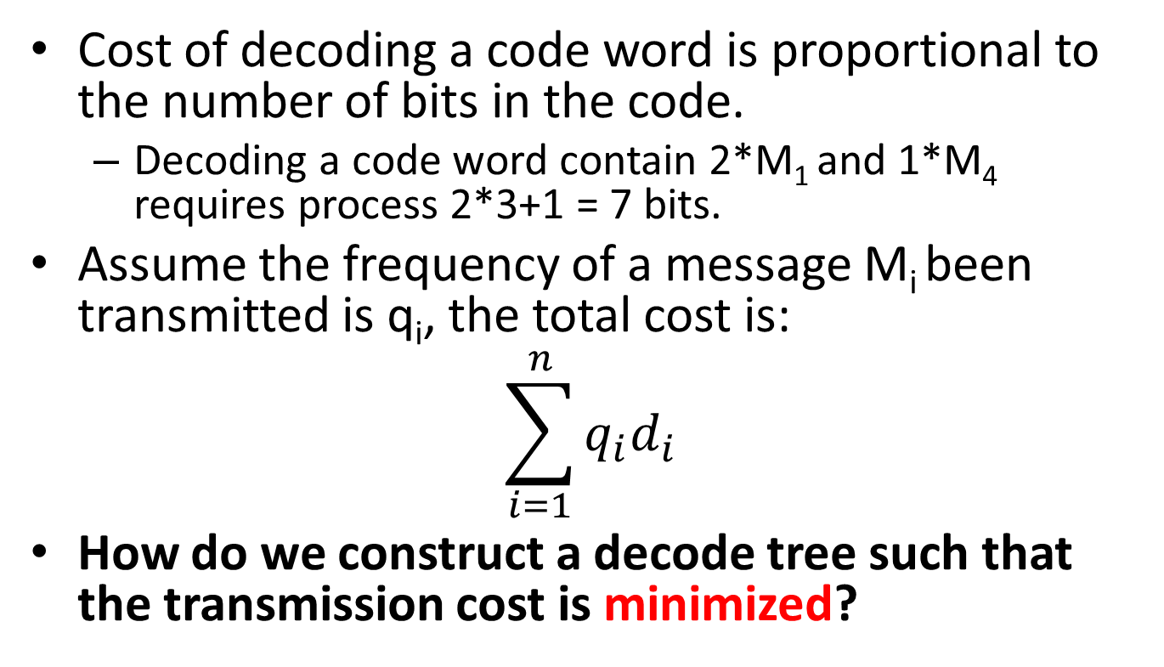
Huffman Codes
Cost of decoding a code word is proportional to the number of bits in the code.
Decoding a code word contain 2*M₁ and 1*M₄ requires process 2*3+1 = 7 bits.
Assume the frequency of a message M_{i} been transmitted is q_{i}, the total cost is:
$$\sum_{i=1}^{n}{q_{i}d_{i}}$$
How do we construct a decode tree such that the transmission cost is minimized?

Slide 18
Weighted External Path Length
Sort the message according to q_{i}
Take the two messages with least q_{i} and combine them into a tree.
Repeat the process until we obtain one tree.
M₁
M₃
M₂
M₄
1/7
1/7
2/7
3/7
M₁
M₃
M₁
M₃
M₂
M₁
M₃
M₂
M₄

Slide 19
Message Encoding
1
0
0
1
1
0
0
1
1
0
0
1
M₁
M₃
M₂
M₄
M₁
M₃
M₂
M₄
 | Huffman Codes
M₁ | 111
M₂ | 10
M₃ | 110
M₄ | 0
 | Huffman Codes
M₁ | 000
M₂ | 01
M₃ | 001
M₄ | 1

